Slide 1




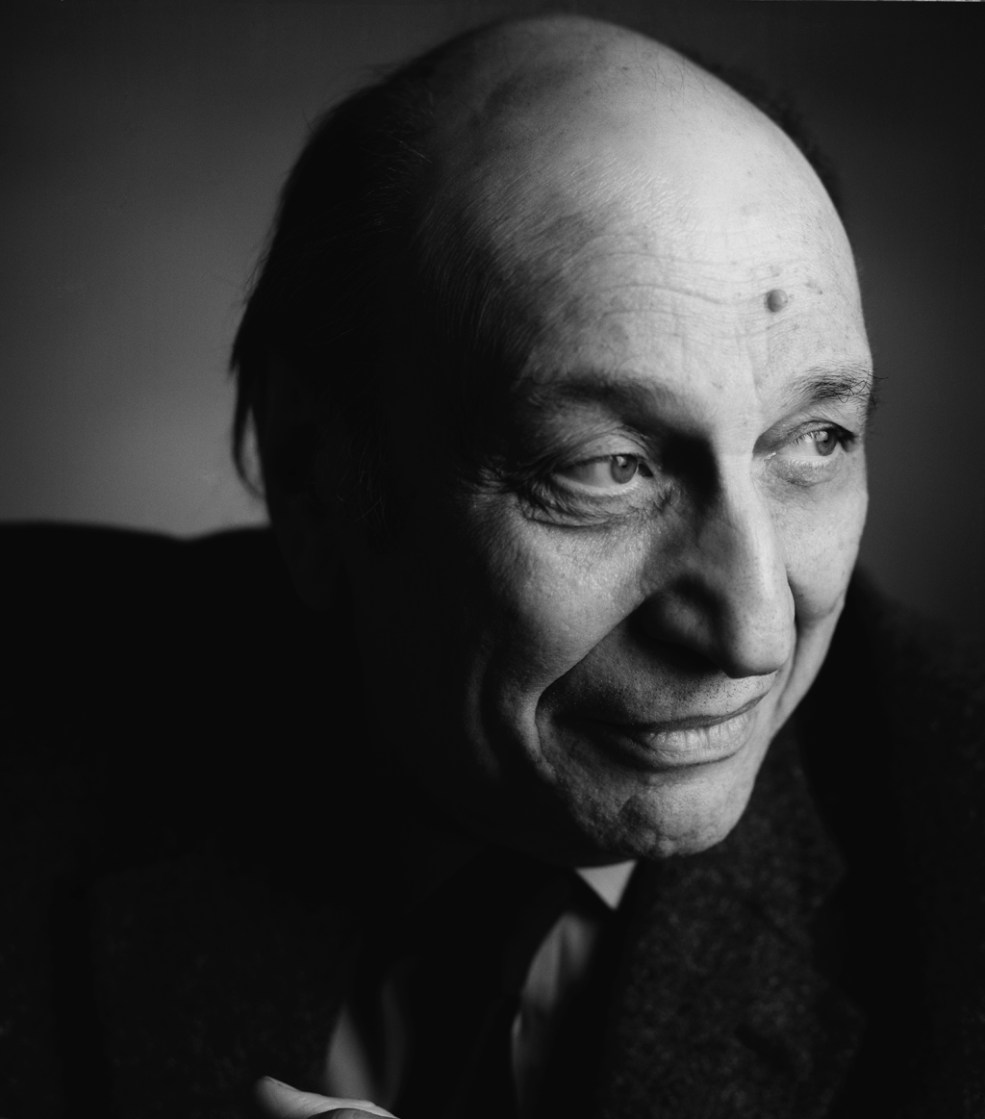
PAULA SCHER
MILTON GLASER

Slide 2

POINTS
POINTS
Who I’ve helped: | What I helped with:
Who I’ve helped: | What I helped with:

Slide 3


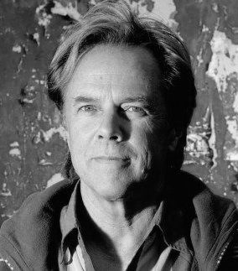
NEVILLE BRODY
DAVID CARSON

Slide 4
POINTS
POINTS
Who I’ve helped: | What I helped with:
Who I’ve helped: | What I helped with:

Slide 5

MILTON GLASER

Slide 6
“There are three responses
to a piece of design –
yes, no and WOW!
Wow is the one to aim for.”
- Milton Glaser

Slide 7
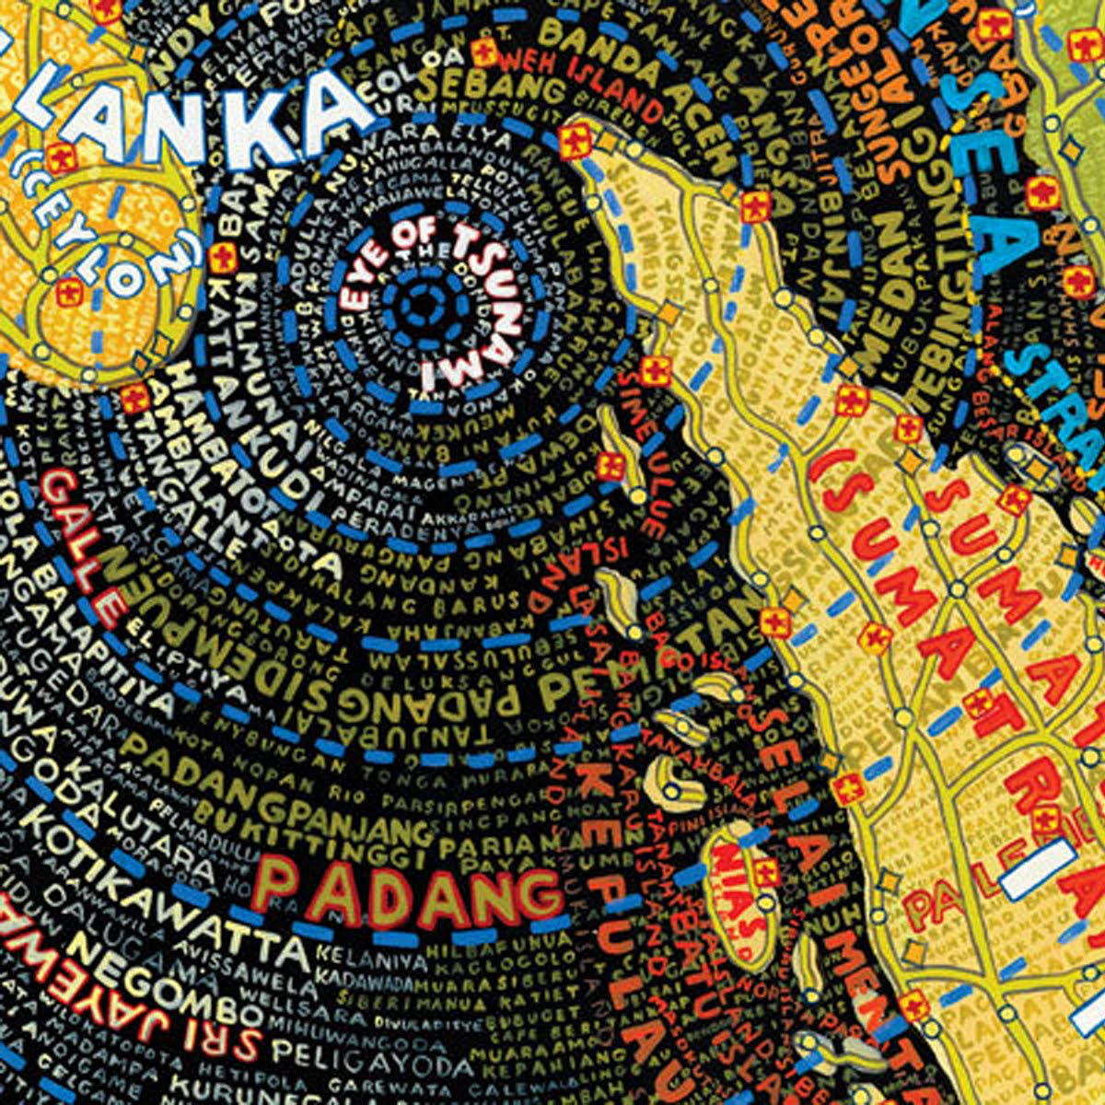
PAULA SCHER

Slide 8
“Its through mistakes that
you actually can grow.
You have to get bad in
order to get good.”
- Paula Scher

Slide 9

NEVILLE BRODY

Slide 10
“Design is more than just
a few tricks to the eye. It’s
a few tricks to the brain.”
- Neville Brody

Slide 11

DAVID CARSON

Slide 12
“Graphic Design will save
the world - right after
Rock and Roll does.”
- David Carson

